Slide 1

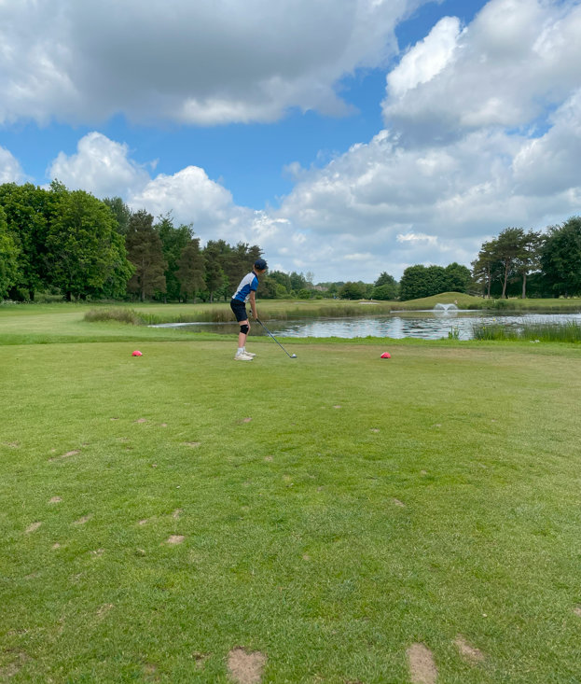
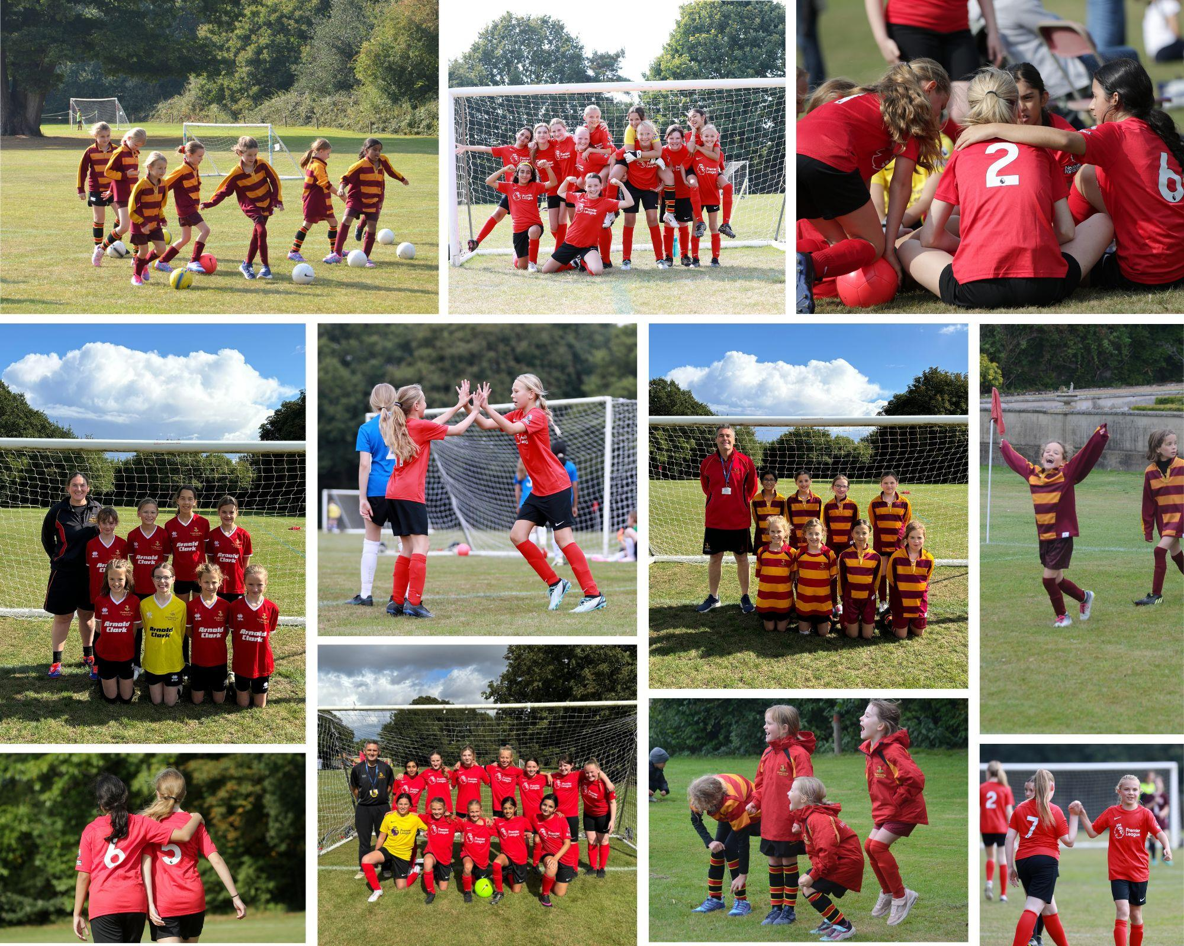

U11 Girls Football Qualifier
U11 Girls Football
Qualifier
Monday 6th October

Slide 2
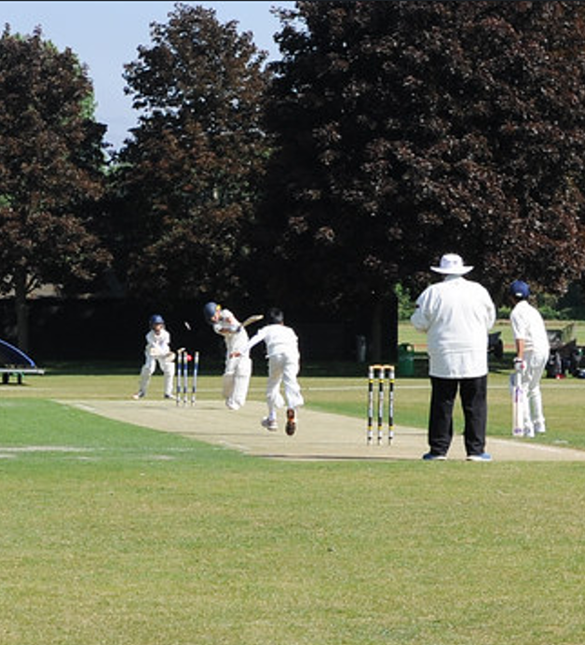
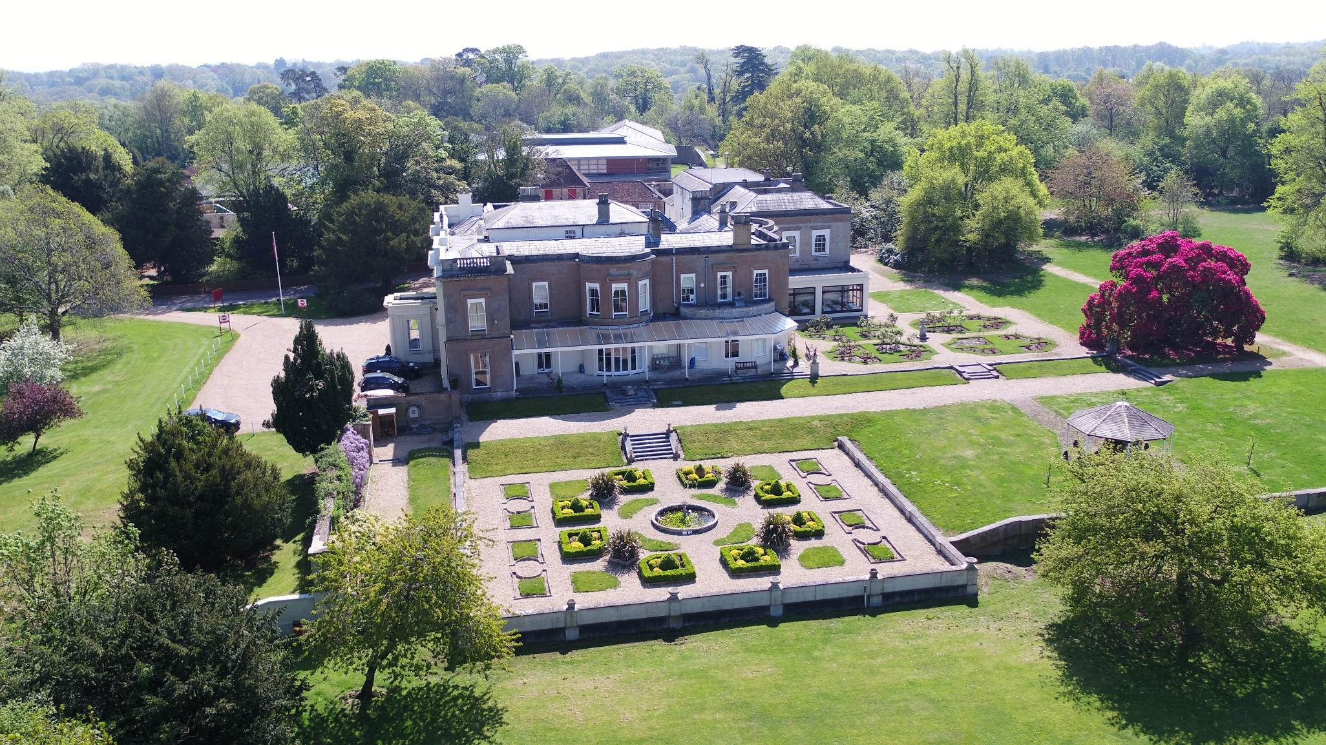
WELCOME FROM SCHOOL
Welcome to Westbrook Hay, an outstanding independent school for boys and girls aged 3-16 years.
The school’s beautiful rural location boasts 26 acres of parkland overlooking the Bourne valley. Located just off the A41, between Berkhamsted and Hemel Hempstead in Hertfordshire, Westbrook Hay has easy access to all major routes.
Westbrook Hay is expanding to offer GCSEs, with our first Year 9 beginning their senior journey this September 2025.
We are unique in being able to offer so much sport to our children and as a result offer an impressive ‘Sport for All’ ethos. Our expansive grounds and wonderful facilities certainly helps and this, along with the success of our teams in recent years, has resulted in us acquiring a fine sporting reputation in the local area.
The quality of our sports coaching is outstanding, with specialist sports teachers employed for all ages across the school. We offer sports scholarships for talented children joining Westbrook Hay in years 7 and 9.

Slide 3

Welcome from IAPS
WELCOME FROM IAPS
First and foremost, sport is about participation and enjoyment. Sport is an incredibly important part of the personal development of children. Thanks to our eager and enthusiastic membership, over 22,000 children take part in the IAPS Sport programme every year. With 22 sports to choose from and over 170 events organised annually, there are plenty of opportunities for our member schools to get involved in.
Whether this is your first time at an IAPS event, or you
have been entering them for many years, we hope you enjoy the competition and good luck!
IAPS Sport

Slide 4
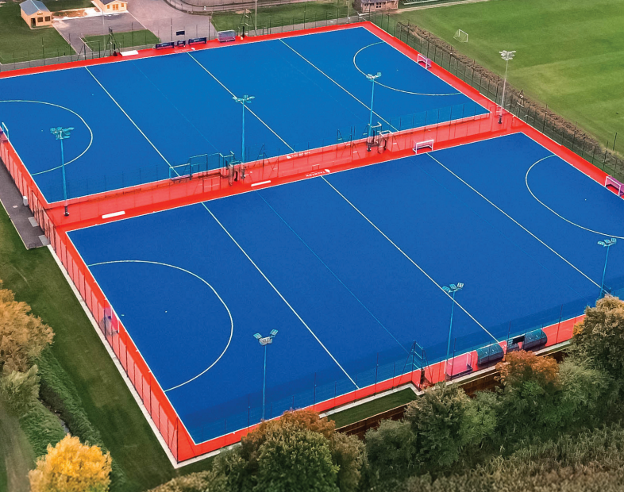
CODE OF CONDUCT FOR SPECTATORS
Where permitted, we are delighted to welcome spectators to attend IAPS events.
As a spectator/parent you have a responsibility to:
Be a positive role model and lead by example. Children are involved in sport for their enjoyment and without undue spectator pressure.
Encourage children to play by the rules and respect the officials.
Always respect the officials and their decisions. Video evidence will not be accepted in any cases to dispute decisions.
Always respect the coaches and their decisions. They give their time, energy and experience to coach the children.
Refrain from any form of bad language or poor behaviour towards players, officials and fellow spectators.
Be friendly and respectful to the opposition.
Teach children that effort and teamwork are as important as victory so that the result of each game is accepted without undue disappointment.
Turn defeat into victory by helping children work towards skill improvement and a positive sporting attitude.
Be aware that IAPS events have comprehensive safeguarding policies and procedures, available on our website: https://iaps.uk/sports/useful-information/documents-links.html
IAPS wants all competitions to run without any negative incidents. Excitement and emotions can run high at events, not least amongst the supporters. Unpleasant and inappropriate behaviour is very rarely seen but you should be aware that IAPS retains the right to ask you to leave the event if you fail to comply with the code of conduct.
Try to relax and enjoy the event!

Slide 5
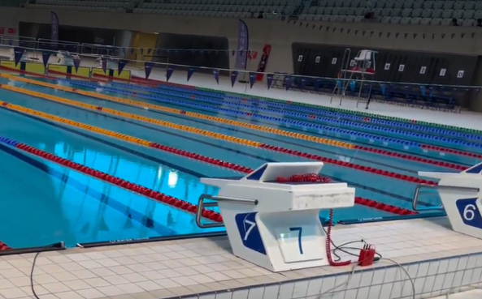
SAFEGUARDING
IAPS believes that the welfare and wellbeing of all children (young people under the age of 18) and adults at risk attending an IAPS event is of the highest conern. All such persons have the right to safety and protection and any suspicions,concerns or allegations of harm will be taken seriously and will be dealt with swiftly and appropriately.
IAPS expects all adults who are engaged with the delivery of sports events to fully comply with safeguarding procedures as laid out in the IAPS Safeguarding Policy and Procedures, and the KCSiE document. These are available on our website.
IAPS expects all coaches present to be DBS checked and have received relevant safeguarding training at their school/club.
IAPS expects that all adults attending events have read the IAPS code of conduct, photo policy and anti-bullying policy. These are available to read and download from our website.
If you have any safeguarding concerns today, please don’t hesitate to speak to Emily Nunan, Mike Kershaw or a member of the organising team.
Emily Nunan
Head of Sport and Pupil Experience
egn@iaps.uk
Designated safeguarding officer
Mike Kershaw
Sport and Pupil Experience Manager
mjk@iaps.uk
Deputy safeguarding officer

Slide 6
EVENT INFORMATION
Parking
Please can all schools park at Little Hay Golf Club (Box Ln, Bovingdon, Hemel Hempstead HP3 0DT). You will then be walked over to the pitches by a member of Westbrook Hay Staff. Spectators my park on school site but must stay within the event parameters at all times.
Late arrivals
As a school if you arrive late and miss the start of your match the opposing school will be awarded the full three points for the fixture. If you know you will be running late please do contact the main office at Westbrook Hay, 01442 256143.
Tournament Schedule
Registration will open at 9:30am with a staff briefing at 10:00am. Matches will start promptly at 10:30am with a toss 5 minutes before kick off.
Referees
As a school we have provided four referees, they are neutral and will stay on one pitch for the entire day.
Qualification process
Due to the number of schools entered into this qualifier, there will be a plate and a cup competition. One school will qualify for the National Finals.
First aid
There will be a provider for first aid and all members of staff at Westbrook Hay are first aid trained. Please ensure you do bring your own first aid kit for minor injuries on the day.
Changing Facilities/Toilets
There will not be any changing facilities for participants to use, however there will be toilets available. Spectators will have toilets (which will be signposted on the day) and participants can use any pupil toilets around the school.
Refreshments
There will be refreshments for all staff and spectators. These will be available after the event aswell as during.

Slide 7


EVENT INFORMATION
Results
Results for team events will be published live using SOCS. Results for individual sports will not be available live but will be published as soon as possible after the event.
Merchandise
IAPS are delighted to have Team Elite as our official merchandisers, to sell branded products both online and at events throughout the year, All commission made from merchandise is directly put back into running the sports programme. Merchandise can be bought online or at several IAPS sport events.
Photography advice
There is no professional photography at IAPS Sports events, however parents and spectators can take their own pictures. There is no law against taking photos at public events for personal use, including pictures of other people’s children (Ask the Police, 2018). IAPS asks parents and spectators to be cautious when sharing any images on social media.
The NSPCC have useful advice on sharing images here: https://learning.nspcc.org.uk/

Slide 8
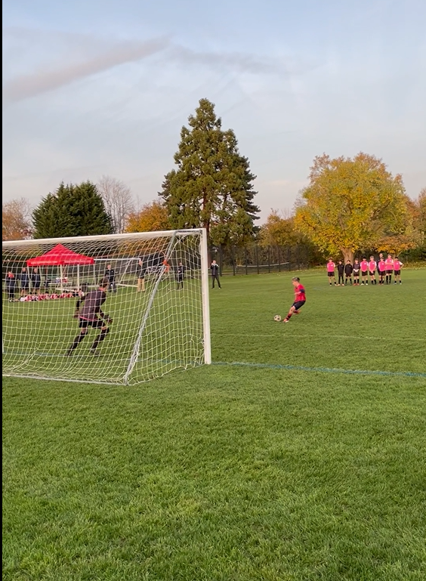
TIMETABLE/SCHEDULE
9:30am onwards | Arrival/Registration
10:00 | Staff/Referee Briefing
10:30 | Group Games Begin
12:30 | Lunch
14:30 | Knockout Games Begin
15:45 | Presentation/Match Teas
16:00 | Depart

Slide 9
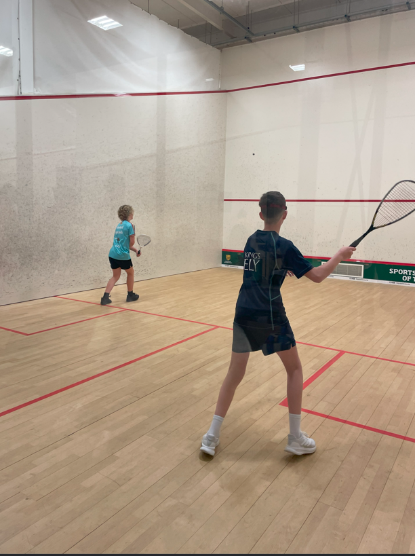
LIST OF SCHOOLS/POOLS
List of schools attending:
 | POOL 1 |  | POOL 2
A1 | Westbrook Hay | B1 | Bute House Prep School for Girls
A2 | St Mary's School, Hampstead | B2 | St George’s School
A3 | St George's Junior School | B3 | Warwick Prep School
A4 | Stormont | B4 | Berkhamsted Prep School
A5 | Stephen Perse Foundation - Dame Bradbury's | B5 | The Marist School - Prep
A6 | Lambrook | B6 | North London Collegiate Junior School
QR Code Link to Fixtures and Results;

Slide 10
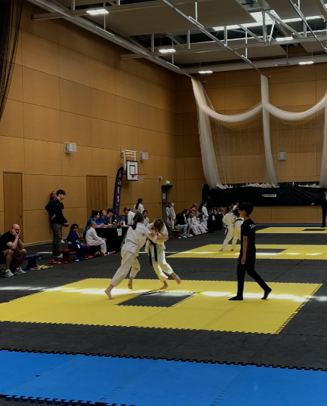
POOL MATCHES
POOL MATCHES
This qualifier consists of 2 pools of 6 teams.
Matches will be 6 minutes each way or 12 minutes one way.
The top 2 placed team in each pool will progress to the cup competition.
The 3rd – 4th placed team in each pool will progress to the plate competition.
The 5th placed team in each pool will play for 9th/10th place.
The 6th placed team in each pool will play for 11th/ 12th place.
KNOCKOUT MATCHES
Matches will be 6 mins each way or 12 mins one way.
 | Pitch 3 | Pitch 5 | Pitch 6
10:30 | A3 vs A6 | A2 vs A5 | A1 vs A4
10:50 | B2 vs B5 | B3 vs B6 | B1 vs B4
11:10 | A6 vs A5 | A3 vs A4 | A1 vs A2
11:30 | B6 vs B5 | B1 vs B2 | B3 vs B4
11:50 | A6 vs A2 | A5 vs A4 | A1 vs A3
12:10 | B5 vs B4 | B6 vs B2 | B1 vs B3
12:30-1:00 | LUNCH | LUNCH | LUNCH
13:10 | A1 vs A6 | A5 vs A3 | A4 vs A2
13:30 | B5 vs B3 | B4 vs B2 | B1 vs B6
13:50 | A1 vs A5 | A2 vs A3 | A4 vs A6
14:10 | B4 vs B6 | B1 vs B5 | B2 vs B3
Cup Competition
 | SF 1 (Pitch 5) | SF 2 (Pitch 6)
15:00 | 1st place pool 1 v 2nd place pool 2 | 1st place pool 2 v 2nd place pool 1
 | FINAL (Pitch 5) | 3rd & 4th place play-off (Pitch 6)
15:30 | Winner of SF 1 v winner of SF 2 | 2nd place of SF1 v 2nd place of SF 2
Plate Competition
 | 11^{th/} 12th place play-off (Pitch 3)
14:30 | 6th place pool 1 v 6thplace pool 2
 | 9th / 10th place play-off (Pitch 2)
14:30 | 5th place pool 1 v 5thplace pool 2
 | SF 1 (Pitch 3) | SF 2 (Pitch 2)
15:00 | 3rd place pool 1 v 4th place pool 2 | 3rd place pool 2 v 4th place pool 1
 | FINAL (Pitch 3) | 3rd & 4th place play-off (Pitch 2)
15:30 | Winner of SF 1 v winner of SF 2 | 2nd place of SF1 v 2nd place of SF 2

Slide 11
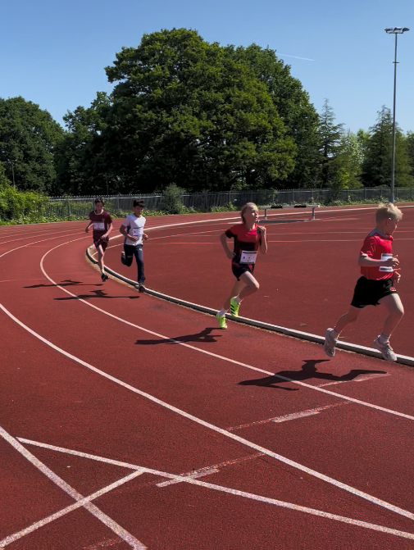
RULES AND REGULATIONS
Rules and regulations:
IAPS football tournaments follow the FA’s small sided football rules
Scoring
o 3 points for a win
o 1 point for a draw
o 0 points for a loss
Pool matches
Group matches will be played on a league basis. The group order will be decided by the number of points scored by each team.
In the event of a tie on points, the following will decide final placings:
1. Goal difference
2. Goals scored
3. Winner of match between the tied teams*
4. Barrage of 3 penalty strokes (3 players selected from the squad)
5. Sudden death penalty strokes**
*Head-to-head result between two teams is the result of the match played between the two tied teams
**Sudden-death is started by the team that did not start the shoot-out and players may proceed in a different order from the initial best-of-three round.
Knockout matches
In the event of a draw at full time, the winner will be decided by:
1. A period of ‘Golden Goal’ extra time. Playing times should be a third of the
original play time e.g. if you played 6 minutes one way during the match, you
should now play 2 minutes extra time.
2. Penalty kick shoot-out (3 kicks per team)
3. Sudden death penalty kicks
Colours
In the event of a colour clash, the first named team will be required to change their shirts. Please provide schools with coloured bibs.

Slide 12
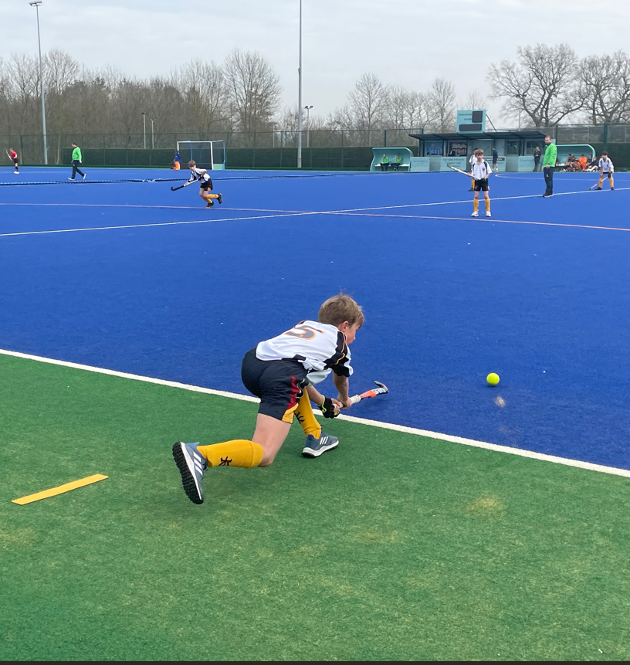
Website
Emily Nunan
https://iaps.uk/sport.html
Head of Sport and Pupil Experience
egn@iaps.uk
01926 461501 (Direct Line)
07469 853452 (Mobile)
Instagram
@iapsuksport
Mike Kershaw
Sport and Pupil Experience Manager
mjk@iaps.uk
01926 461513 (Direct Line)
07884 453783 (Mobile)
X
@iapsuksport
Email
Rachel Eatough
sport@iaps.uk
Sport and Pupil Experience Administrator
rae@iaps.uk
01926 887833, extension 210

