Slide 1


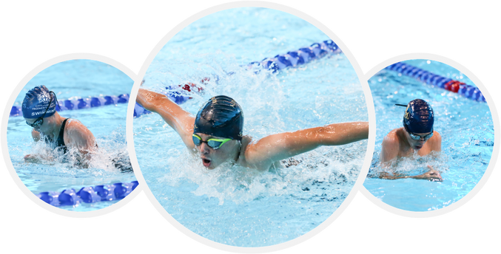

This certificate is awarded to:
For participating at the IAPS Swimming Finals, London Aquatics Centre
Saturday 6th June 2026
Head of Sport and Pupil Experience
Date

